Slide 1
Introduction to Machine Learning with R
George Papadopoulos

Slide 2
Aims of this session
The aims of this introductory session is to cover Machine Learning with R and how to apply the basic workflow using MLR toolbox.
More specifically, we will cover the following:
Supervised and Unsupervised Learning
Meta Algorithms and model Validation
Modelling workflow
Application examples using MLR package in R

Slide 3
Machine Learning
Machine Learning (ML) is the process of utilising patterns and inference to enable computer systems perform certain tasks without using explicit instructions.
Key aspects of ML include the following:
  ML systems are based on supplied data to train the system
  Making use of Mathematical Models to map the underlying data
  Machine learning algorithms are used in a wide variety of applications, such as email filtering, and computer vision, where it is infeasible to develop an algorithm of specific instructions for performing the task.
  Machine learning is closely related to computational statistics, which focuses on making predictions using computers.
  The study of mathematical optimization delivers methods, theory and application domains to the field of machine learning. Data mining is a field of study within machine learning, and focuses on exploratory data analysis through unsupervised learning.
  In its application across business problems, machine learning is also referred to as predictive analytics.

Slide 4
Supervised Learning
Machine learning task the input/output data pairs are mapped to a function
Training data must have examples of input output relationship
  Training data is analysed and a function is inferred to describe this relationship. This can be used to map new information/examples
Optimality criteria are in place to ensure correct allocation of classes/labels for predicted instances
  Proper training will ensure that the model will generalise well to unseen data
  An objective function is commonly used along with a set of constraints to determine the value of the model/function parameters
Examples: any regression methodology, SVM, NNs, etc

Slide 5
Unsupervised Learning
Unsupervised learning is a type of self organised learning that exploits relationships within the data to discover classes/labels
  Similar to how self organised Hebbian learning
  No training input / output pairs are required
Also related to self-organization and able to model probability densities of the data variables
It is one of the main three categories of machine learning, along with supervised and reinforcement learning.
Other hybrids include the Semi-Supervised learning where the two major categories of supervised and unsupervised learning are combined
Examples: PCA, Cluster Analysis, Density Estimation (KDE etc), NNs

Slide 6
Meta Algorithms and Validation
In computer science and mathematical optimization, a metaheuristic/meta algorithm is a higher-level procedure or heuristic designed to either select an optimal methodology or combine several ones to provide a better result
  These techniques may provide better solutions based on an incomplete information or when the system has limited resources^{[1][2]}
  Examples: Boosting^{[3]} ^{[4]}
Cross-Validation is the process where a portion of the data is used at a time to train the system with the rest used as the test set
  This is conducted multiple times with the window of training and testing data being rotated
  This is a type of model validation technique for assessing how the results of a statistical analysis will change when independent/unseen data is introduced
  It is used primarily with prediction in mind and the goal is to estimate how accurately a predictive model will perform in practice.

Slide 7
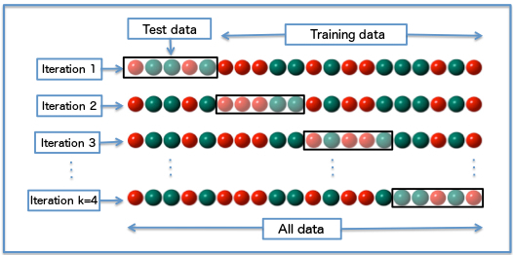
Schematic Diagram of Cross Validation
Source: Wikipedia

Slide 8
Modelling Workflow in MLR
Is the model adequate?
Pre-Processing
Create Task
Create Learner
Train Model
Yes
Predict or
Simulate
No
Set Model Parameters
Tune Parameters
Resampling
Source: MLR Package

Slide 9
Resources
Statistical Pattern Recognition, 3rd Edition
Applied Linear Statistical Models
MLR Package
The Nature of Statistical Learning Theory
Engineering Optimization: Theory and Practice, Fourth Edition
Probability, Random Variables And Random Signal Principles
Probability, Random Variables, and Stochastic Processes

Slide 10
Application Examples
Code in R is provided here
The examples illustrate how to use the MLR package in R based on the modelling workflow described earlier
MLR offers a plethora of methodologies to work with
Offers adequate visualization
It can be extended to use customised measures and modelling techniques

Slide 11
Any Questions?

